Slide 1

Encryption and Cryptography
Gerhard Steinke

Slide 2
Can you decrypt these?
mfuttubsu
cepninotry

Slide 3
What is Encryption?
Secret writing
Disguising message
Storing and transmitting information so content only revealed to intended target
Based in logic and mathematics

Slide 4
Why Encryption?
Confidentiality
Only specific folks can read message.
Integrity
Assured that message not altered
Authentication
Know who really sent message
Non-repudiation
Sender cannot deny they sent message.

Slide 5
Terminology
Plaintext – clear text, original information
Ciphertext – scrambled, message after encryption
Encryption - process of transforming plaintext into ciphertext
Decryption - recovering plaintext from ciphertext
Algorithm, cipher - mathematical function… (publish?)
Good algorithm leaves no pattern
Key - secret information used by algorithm

Slide 6
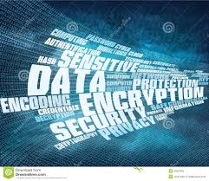
Breaking Encryption
Brute force - try all possible keys
key length makes a difference
Replace encryption software
Flaws in system – bypass encryption
Steal, bribe

Slide 7
Applications for Encryption
Data storage
Passwords
Files, Databases, Backup files, Email
Communication/sessions
Digital signature
Verifying source
Non-repudiation
VPN

Slide 8
Encryption Algorithms/Ciphers
Substitution Cipher (13)
ABCDEFGHIJKLMNOPQRSTUVWXYZ
↓ ↓ ↓ ↓ ↓ ↓ ↓ ↓ ↓ ↓ ↓ ↓ ↓ ↓ ↓ ↓ ↓ ↓ ↓ ↓ ↓ ↓ ↓
NOPQRSTUVWXYZABCDEFGHIJKLM
Transposition Cipher
Rearranging all characters in the plaintext
1234 becomes 4132
“computer” becomes “pcmoruet”
Attack: frequency analysis of letters

Slide 9
Steganography
Hiding information in pictures, sound files without significant to change to original file
http://www.jjtc.com/Steganography/
S-tools

Slide 10
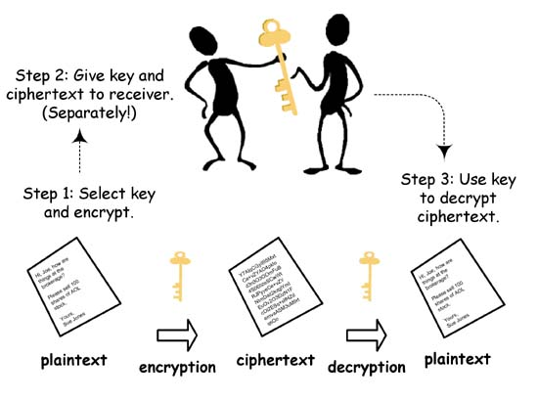
Symmetric/Secret Key Encryption
Single key for encryption and decryption
Key - transmitted a different way

Slide 11
Symmetric / Secret Key
Strengths:
Fast algorithms – very quick encryption
Difficult to break when large key sizes
Weaknesses:
Secure key distribution required
Scalability - n users require n*(n-1)/2 keys
Attacked by exhaustive search of key space
Only supplies confidentiality
DES - Data Encryption Standard – 1976

Slide 12
Data Encryption Standard (DES)
1977, by NIST for unclassified info
56 bit key + 8 parity bits
Cipher block chaining - depends on previous block
Brute force: cracked in 1997 in 5 months, in 1998 in 3 days
Default in many VPN solutions, PGP
Variants - Triple DES, RC5 (RSA), IDEA (128),...
Rijndael – current NIST standard

Slide 13
Asymmetric / Public Key Encryption
Introduced in1976 by Diffie and Hellman
Two keys – one encrypts, the other decrypts
Public and private keys generated as a pair
Private key for user
Public key for distribution
Each key decrypts what the other encrypts
Intensive computations, slower
Confidentiality, integrity, authentication and non-repudiation

Slide 14
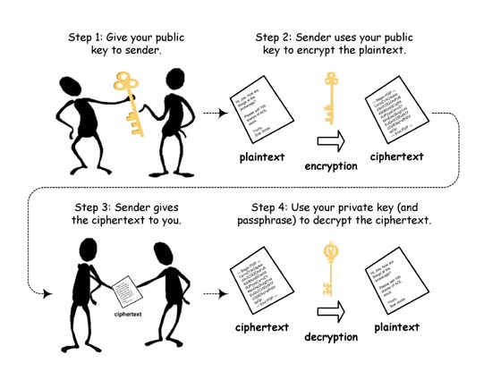
Private & Public Keys
Public Key
Distributed freely
Used to encrypt message
Used to verify signature
Kept in the digital certificate
Private Key
Protected by owner
Used to sign message
Used to decrypt messages
Stored by the owner
On a PC
On a Smartcard

Slide 15
Asymmetric Encryption Algorithms
Factoring with two large prime numbers
Inventors Rivest, Shamir, Adelman 1977 (RSA)
Key lengths 512 bits and more
Used in web browsers with SSL
Calculating discrete logarithms
Diffie-Hellman
El Gamal
key lengths 512-1024
Unpatented
Elliptic Curve Crypto (ECC)
Smaller key size, faster, ideal for smart cards, PDAs

Slide 16

Application
Hybrid – Asymmetric and Symmetric Encryption
Key distribution
Asymmetric
Bulk encryption
Symmetric

Slide 17
Hash / Message Digest Function
Create hash value / digital fingerprint
Provides integrity checking
Shorter than original message
Variable length message to fixed length hash value
One way function, can’t go back
Appended to message
Examples:
MD5 - 128 bit hash
SHA - 160 bit, by NIST, NSA in DSS (Digital Signature Standard)

Slide 18
Digital Signatures
Create a digest - hash value
Encrypt hash value with your private key
Attach to message to be sent
Could encrypt with recipient’s public key
Send

Slide 19
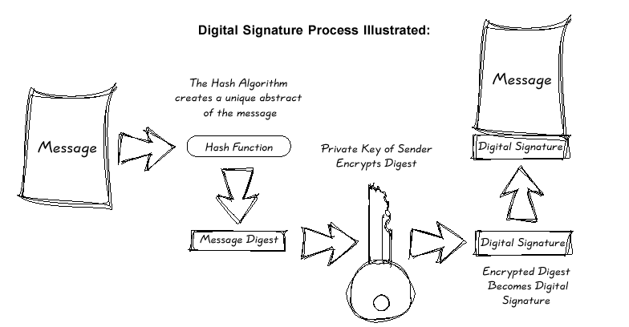
Digital Signature
Diagram from Rainbow Technologies – PKI White Paper

Slide 20
What does Digital Signature do?
Integrity – Message not changed
Authentication - Verify sender identity and message origin
Creates non-repudiation
Used to authenticate software, data, images
Used with electronic contracts, purchase orders
Protect software against viruses
Digital Signature Standard – NIST 1991
Uses DSA and SHA
Digital Signature Algorithm (DSA)

Slide 21
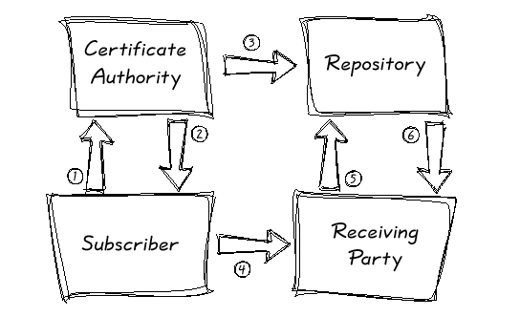
Public Key Infrastructure (PKI)
System, framework, infrastructure
Applications and services that enable public keys
Certificate Authority (CA)
Digital certificate
Digital signature
Certificate Revocation List (CRL)
Certificate Publication Point

Slide 22
Certificate Authorities (CA)
Trusted third party – CAs
Issue public key certificates
Verify identity of individuals to their public keys
Construct certificates
Get digital certificate, signed by a CA to verify recipient’s identity and public key
X.509 – standard for certificates
Internal management
External vendor – e.g.,Verisign

Slide 23
Digital Certificate
Send your public key and ID to CA
Certificate is created with hash signed by CAs private key
When you receive someone’s certificate, you check hash
Basis of Public Key Infrastructure
X.509 certificates
Certificate chains - hierarchy of trust

Slide 24
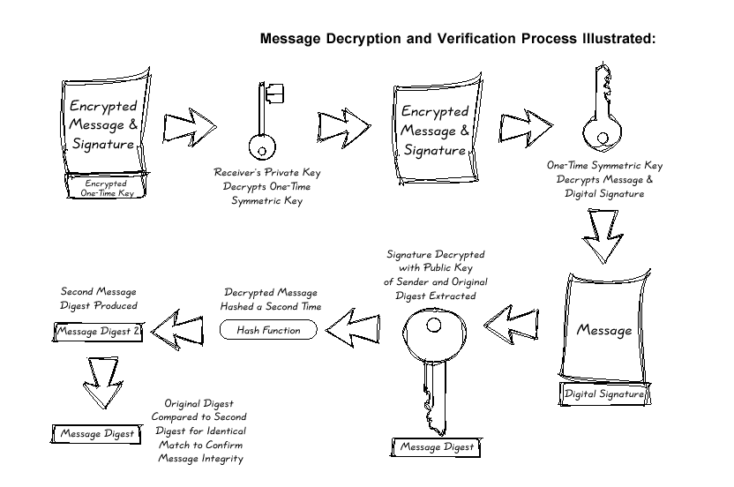
Public Key Infrastructure (PKI)
All Diagrams from Rainbow Technologies – PKI White Paper

Slide 25
Key Management Tasks
Generating keys
Storing keys
Protecting keys
Transferring keys
Verifying keys
Revoking keys
Lifetime of keys
Lost keys – recovering keys
Compromised keys -Certificate Revocation List (CRL)
Key escrow
Backup keys
Verification and certification
Single source / Multiple sources
Government role

Slide 26
Breaking Keys
Specialized hardware
DES cracking 56 bits in hours
NSA?
Brute force, networked environment
Cost to break, value of info, key length
Symmetric vs. asymmetric
40 bit symmetric key = 384 bit public key

Slide 27
Encryption Issues
Interoperability
Key Management
Integration within products
Robustness
Length of time security is needed

Slide 28
Resources
http://computer.howstuffworks.com/encryption.htm
http://www.cacr.math.uwaterloo.ca/hac/
https://www.rsaconference.com/
Other topics:
SSL, https, digital certificates

